Slide 1


TREASURETROVE: Money Control
Milestone 3 – Advanced Prototype
Data & Knowledge Engineering Group
15. JUNE 2021
LAKSHMI HARIKA NAKKA (Scrum Master/Developer)
MIMRAZ HASSAN (GIT Reports)
MUHAMMAD FAIZAN ASLAM (System Design /Blog Maintanence)
VENKATA SUBBA RAJU KANUMURI (Developer & Implementation& Funktional Testing)
PRESENTED BY: Venkata Subba Raju Kanumuri
Lakshmi Harika Nakka

Slide 2
Background
Where were we at??
Presenting the advanced prototype version
Methods of implementing UI elements, Layouts and testing performance
Modeling wokflow and processes using Use case and Activity Diagrams
Static modeling using ,objects and their relationships
Requirement formulation, analysis and mapping to user stories
ADVANCED PROTOTYPE
04 IMPLEMENTATION
03 BEHAVIORAL MODELING
02 STRUCTURE MODELLING
Requirement Analysis

Slide 3

Overview
Design Patterns
UI Design
Advanced Prototype Demo
Use of creational structure and behavioral patterns for specific scenarios
Specifying context of use, UI elements and design solutions
Presenting a working prototype
1
3
5
Advanced Prototype
2
4
Implementation Conventions
Updated System Specifications
Considerations while coding and conventions employed
Updated requirements and class diagrams. Implementation of new features and improvements in Design.

Slide 4
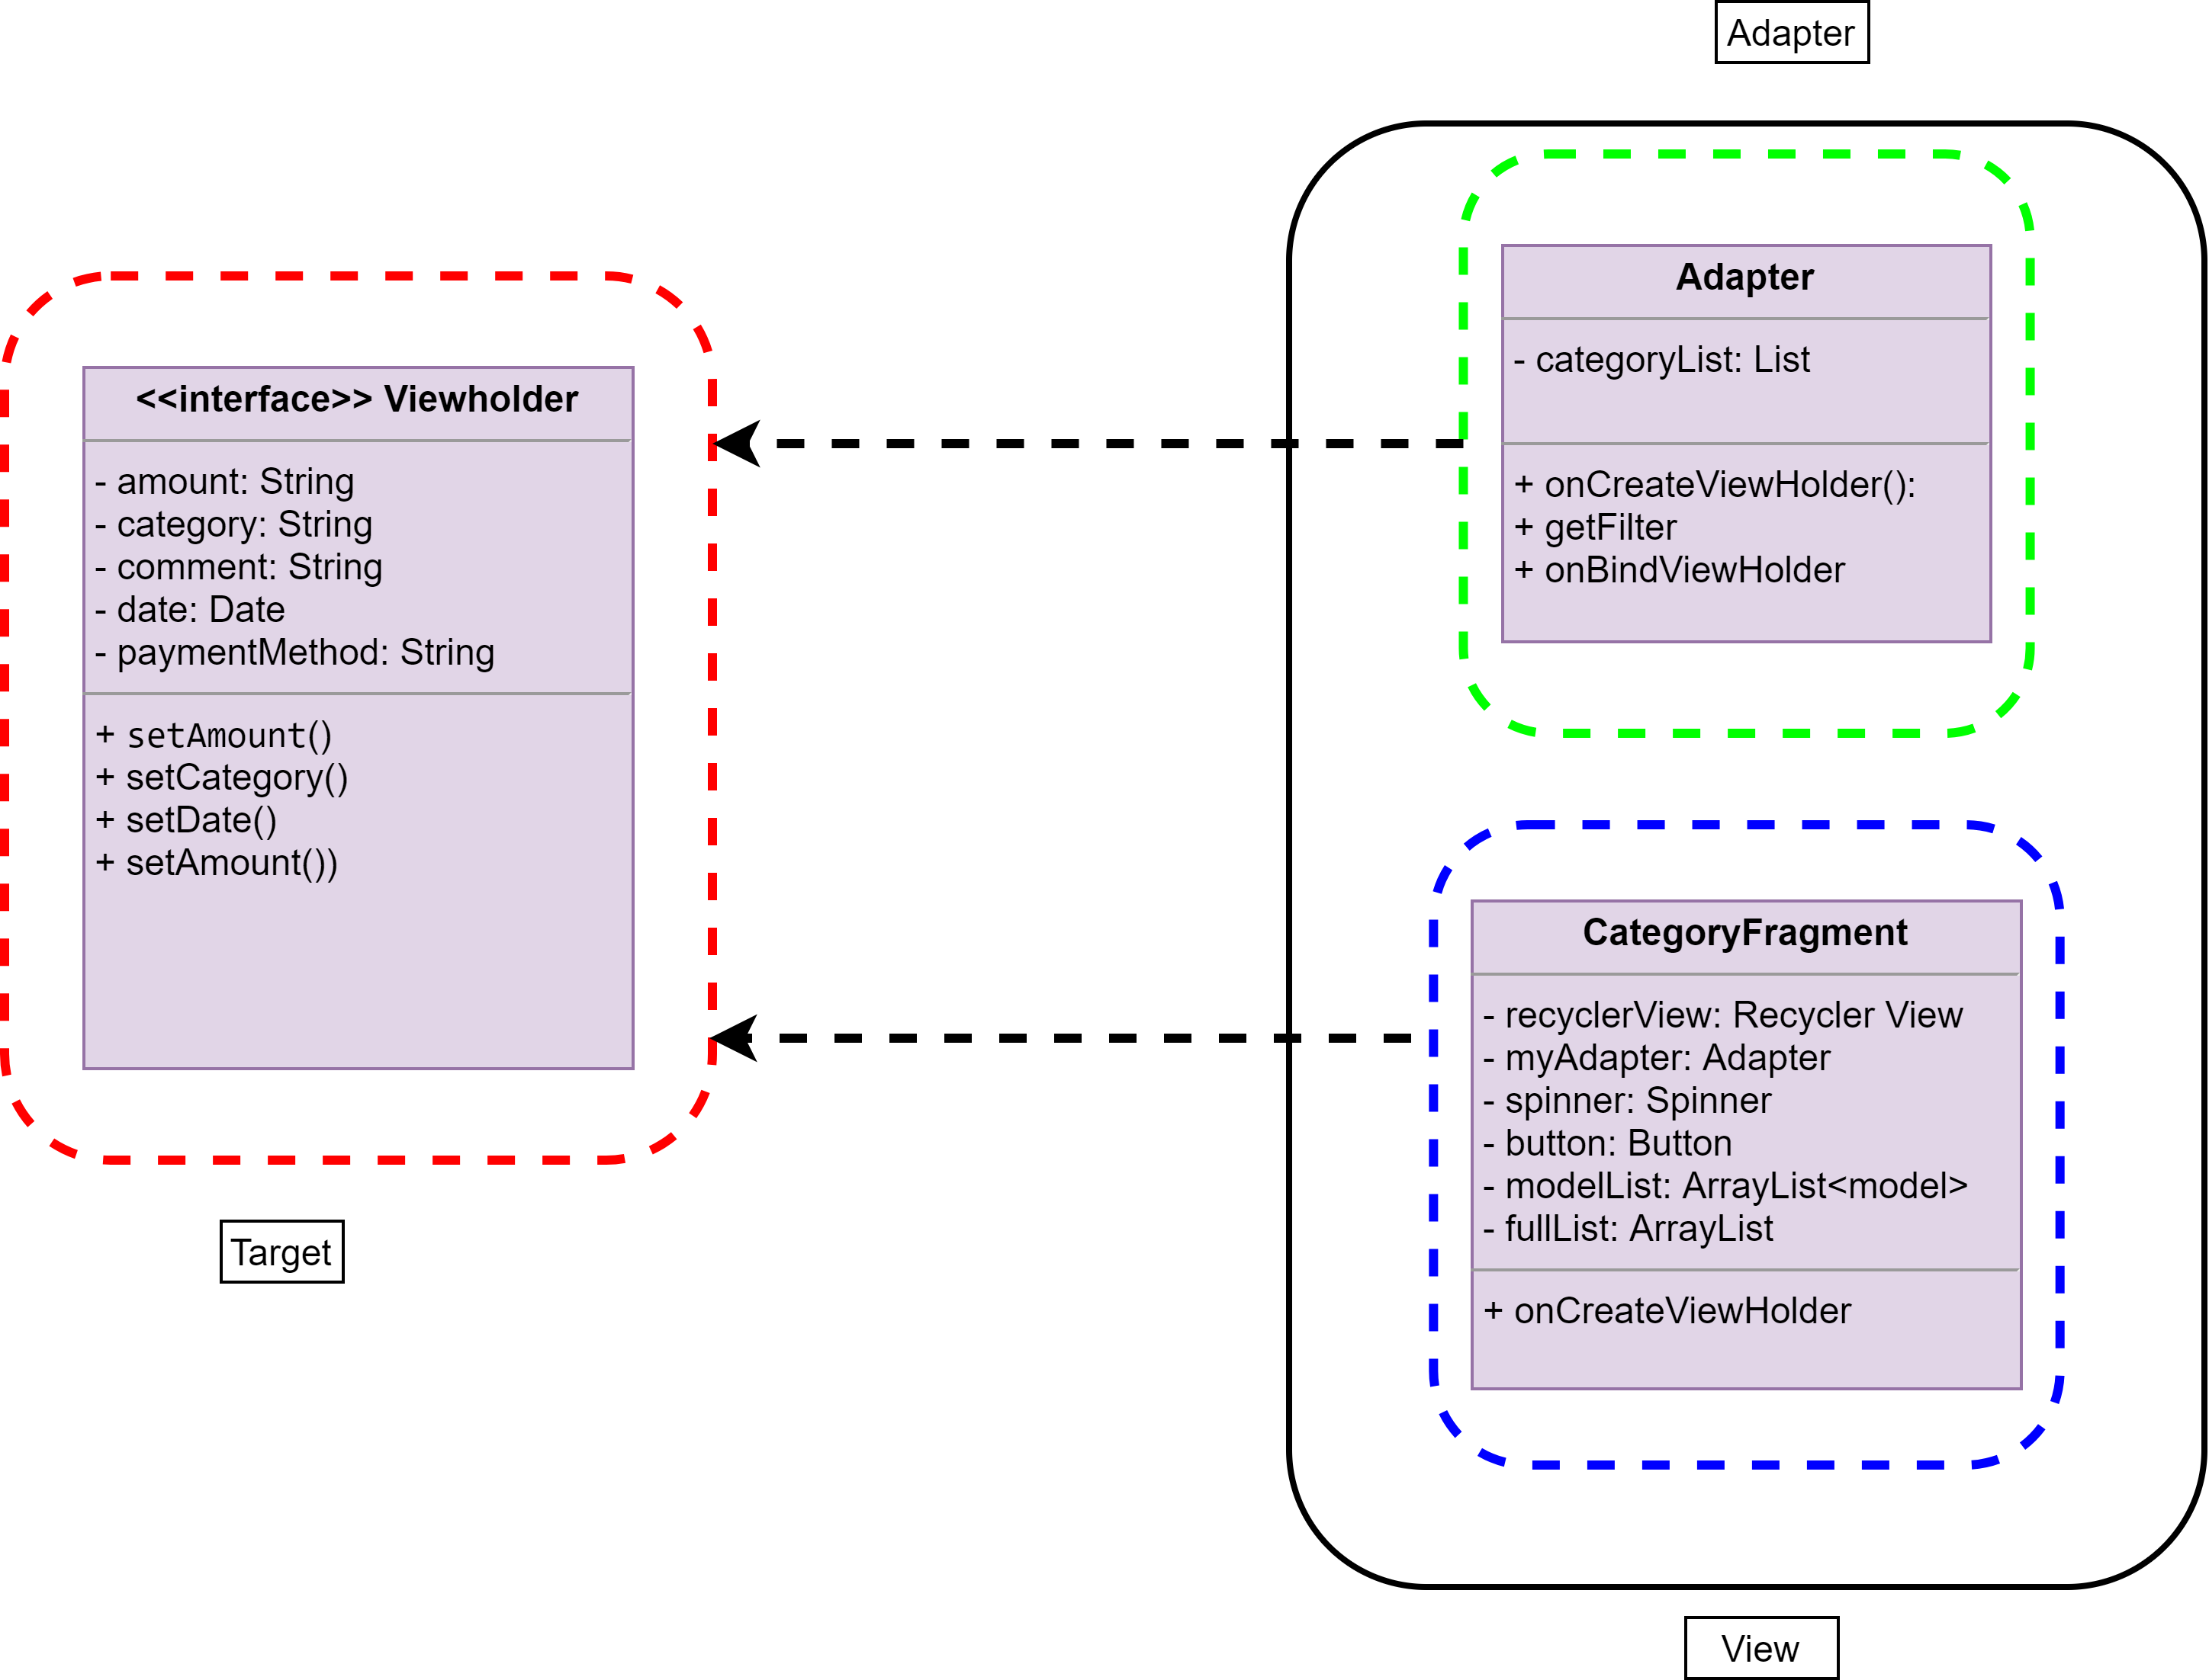
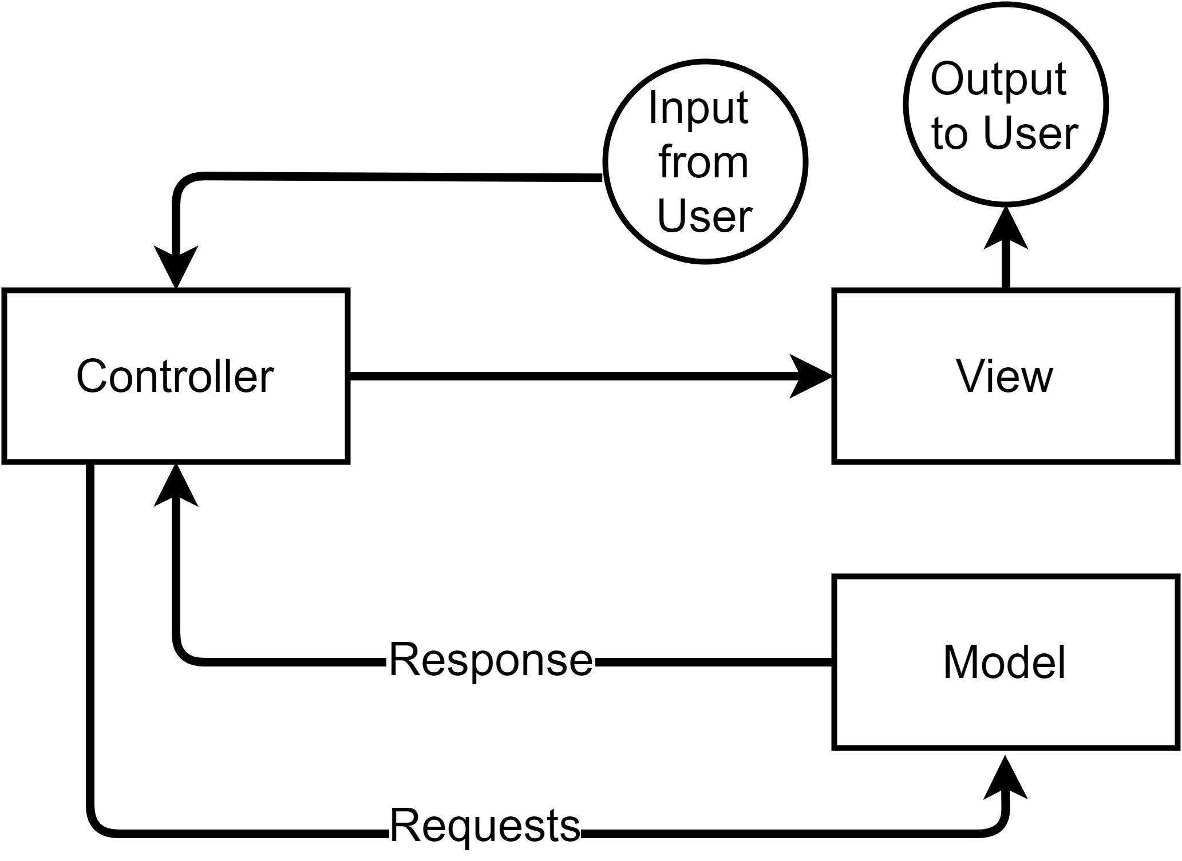
Design Patterns Structural & Behavioral
Adapter Pattern
MVC Pattern

Slide 5
Implementation
Readability
1
4
Functionality
Efficiency
2
5
Elegance
Maintainability
3
6
Modularity
Objectives while Coding

Slide 6
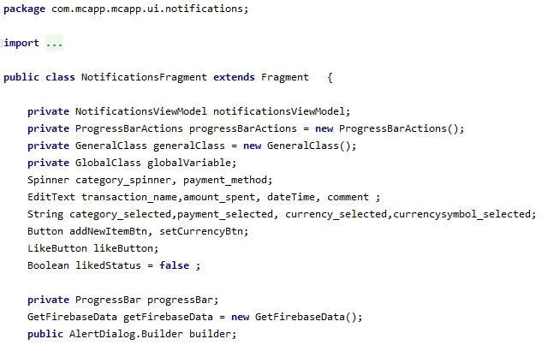
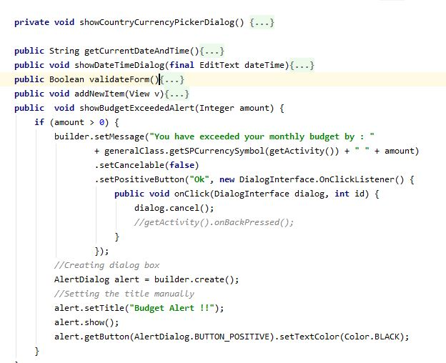
Coding Conventions
First letter lower in Methods. Methods name represent their functions.
Lowercase notation for packages
Indentation for readers convenience
CamelCase notation used for classes
Descriptive but brief identifiers for variables/objects

Slide 7
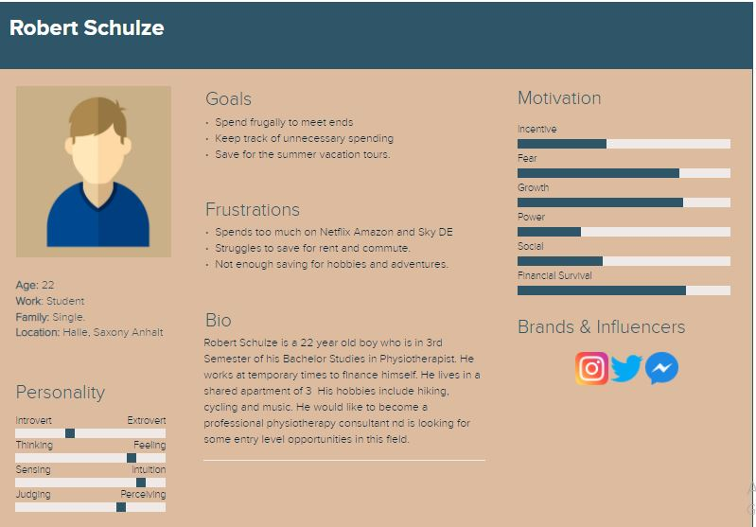
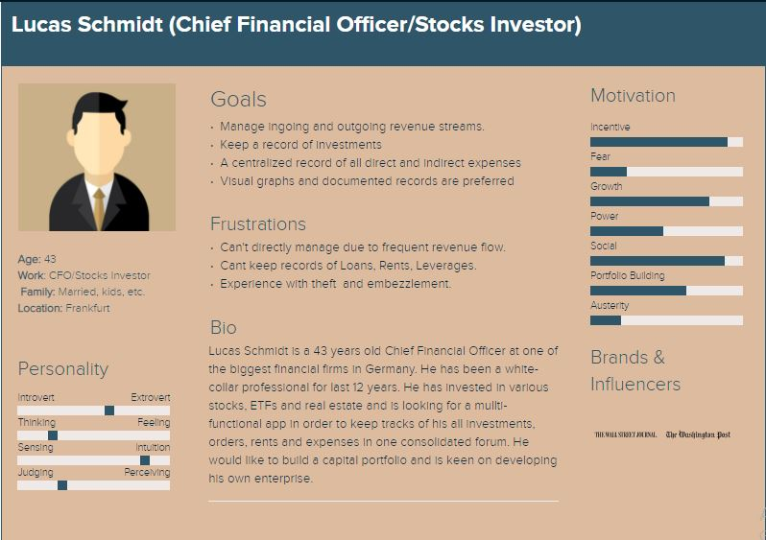
User Interface Design – Context of Use
VS

Slide 8
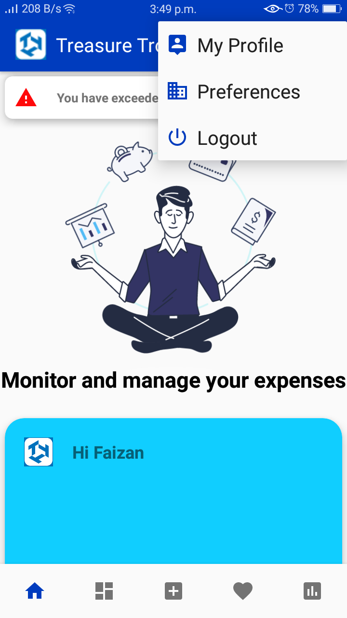
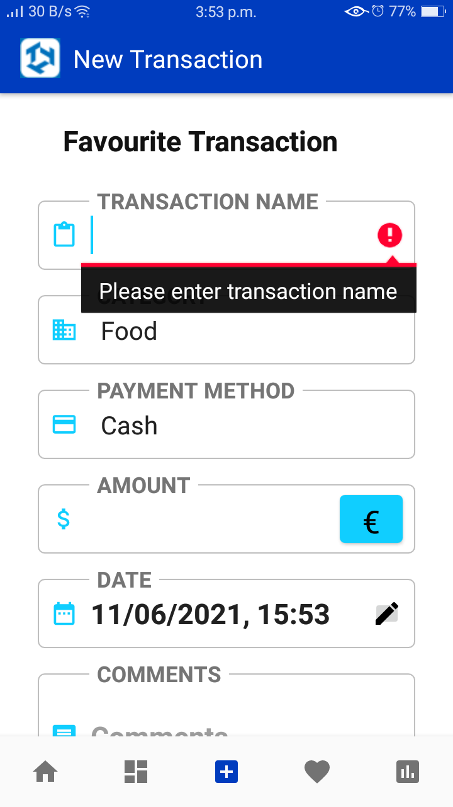
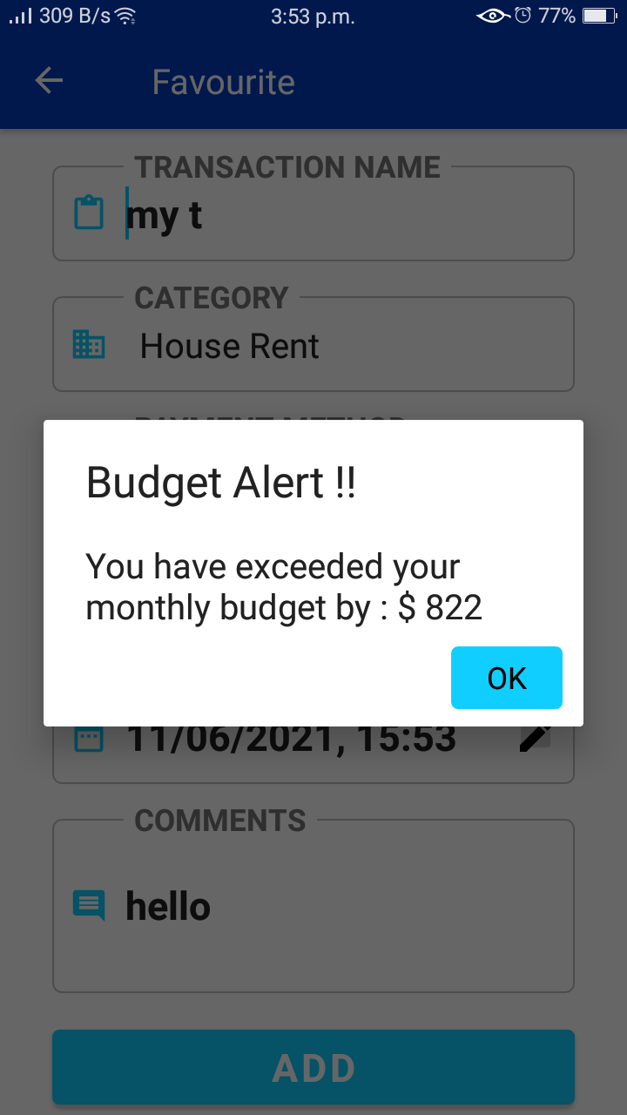
UI Elements
Message boxes for information
Dropdowns display a list of exclusive items
Text fields: single or multiple inputs
Text fields: single or multiple inputs
Notifications
Date Inputs
Pagination : Navigating through different pages
Input controls
Navigational Components
Information Components

Slide 9
Updated Requirements
Necessary Requirements
Budget planning (thresholding)
Repeat transactions(manually or cyclic)
Essential Requirements
Easy to insert input numbers(keyboard).
Multiple currencies available
Some offline functionality.
Nice to have Requirements
Export/Import data into .pdf, .xl file formats
Availability of Multiple Environments/Sessions.

Slide 10
Requirement Analysis - User Stories
As a user, I want the help page to quickly understand how the application works and know its full functionalities.
As a foreign student I should be able to set a default currency and convert other currencies to it
As a student, I should be able to get information about my average expenses on per week or month.
As a finance professional I would like to import and export my records in pdf/xl files.
As a user I must be able to add personal comments with each transaction
Release
4
As a professional I should be able to set-up different environments for different purposes on same account
As a frequent traveller I should be able to basic record offline for times when internet is inaccessible.
As a user I must see my transactions in the form of graphs or charts for better visual representation
Release 5
As a user I should be able to see icons associated with each category
Release 6
As a user I should be able to set recurring transactions with updated time manually
As a user I should be able to get timely suggestions based on my threshold and expenses

Slide 11
Updated Class Diagrams

Slide 12
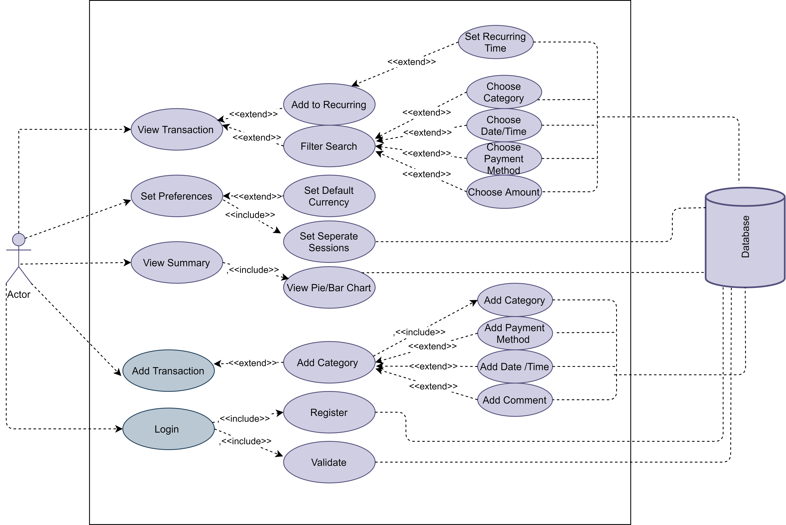
Updated Use Case Diagrams

Slide 13
 | Implementation Strategy (KANBAN Board)
 |  | Sprint 1 : 20.04.2021-04.05.2021 |  | Sprint 2: 07.05.2021-21-05.2021
DONE |  | Team introduction Roles assignment Task scheduling Repository setting First week report | User stories Use case diagrams Finalized development of UI components and layouts | Basic category dashboard implemented class diagrams Basic functionalities of Date/Time, payment method, comments | Basic prototype with priority features Blog compiled Working app tested
DOING |  | Implementation ideas Layout and UI Design Kickstart development of UI elements and layouts Assign tasks | Set up the blog Get feedback from TA regarding UML diagrams Development strategy for recurring transaction functionality | Testing the functionalities of the app Updating Blog and System design Finalize essential features | Prepare slides for milestone presentation Update blog after feedback Rigorously test the app and provide feedback
TO DO |  | Requirements elicitation User stories Requirement mapping Use-Case diagrams | System design Class diagrams Activity diagrams Development of essential features: Add/Delete category Date & Time Payment method Adding filter search feature | Adding recurring transaction functionality. Add Firebase integration for data storage. Adding visual graphs in home dashboard | Improving aesthetics on feedback Demo of working prototype and all functionalities Final presentation
Sprint 3: 23.05.2021-12-06.2021
Advanced category Dashboard. design patterns employed in the implementation, coding conventions Design of detailed software architecture. | UI design solutions and the advanced prototype with added functionalities. Addition of recurring transactions, multiple environments Setting default currency Budget Planning
Testing the functionalities of the app Updating Blog Variations and addition in the system specifications | Prepare slides for milestone presentation Update blog after feedback Rigorously test the app and provide feedback
Offline version of the application. Simple Reccomendations. Explicit conversion of currency based on the volatile rates. | Permission to access contacts for quick transaction additions. Simple recommendations. Exporting and importing of contacts to an excel sheets

Slide 14
What Next??
Development of the Beta Prototype………SPRINT 4

Slide 15
APPLICATION DEMONSTRATION…….
Data & Knowledge Engineering Group
BY : Lakshmi Harika Nakka

